Slide 1
Using Deep Learning To Implement Domain Generation Algorithm
Student: Chia-Ruei Lee
Advisor: Chia-Mu Yu

Slide 2
Contents
A. Introduction
1. Botnet
2. Domain Generation Algorithm
B. Deep Learning
1. Neural Network
2. Auto-Encoder
3. Generative Adversarial Networks (GAN)
4. Wasserstein GAN (WGAN)
5. Improved Wasserstein GAN
C. Using GAN To Implement DGA
1. Requirement

Slide 3
Botnet
Introduction

Slide 4
Domain Generation Algorithm
Introduction

Slide 5
Neural Network
Deep Learning

Slide 6
Auto-Encoder
Deep Learning

Slide 7

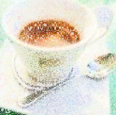
Auto-Encoder
As close as possible
NN
Encoder
NN
Decoder
code
Randomly generate a vector as code
NN
Decoder
code
From Hung-yi Lee, “Generative Adversarial Network/Basic Idea/Machine Learning and having it deep and structured (2017,Spring)”
http://speech.ee.ntu.edu.tw/~tlkagk/courses_MLDS17.html

Slide 8



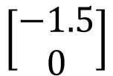
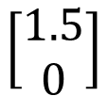
Auto-Encoder
2D
NN
Decoder
code
NN
Decoder
$$\left[\begin{aligned}1.5 \\ 0\end{aligned}\right]$$
-1.5
1.5
$$\left[\begin{aligned}−1.5 \\ 0\end{aligned}\right]$$
NN
Decoder
From Hung-yi Lee, “Generative Adversarial Network/Basic Idea/Machine Learning and having it deep and structured (2017,Spring)”
http://speech.ee.ntu.edu.tw/~tlkagk/courses_MLDS17.html

Slide 9

Auto-Encoder
From Hung-yi Lee, “Generative Adversarial Network/Basic Idea/Machine Learning and having it deep and structured (2017,Spring)”
http://speech.ee.ntu.edu.tw/~tlkagk/courses_MLDS17.html

Slide 10
Generative Adversarial Networks (GAN)
Deep Learning

Slide 11
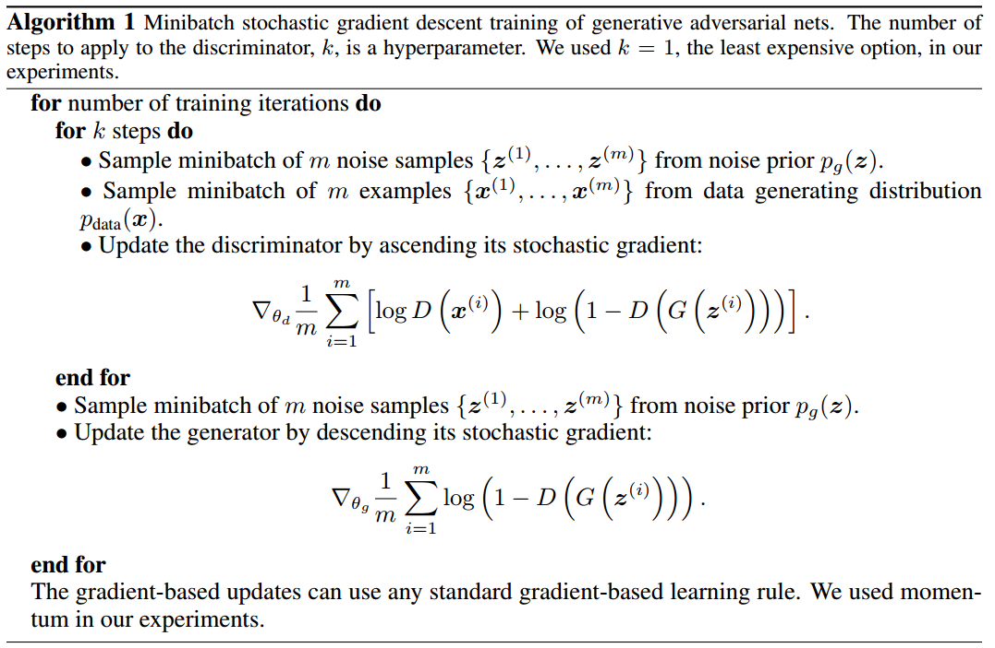
Algorithm
From “Generative Adversarial Networks”
https://arxiv.org/abs/1406.2661

Slide 12
Wasserstein GAN (WGAN)
Deep Learning

Slide 13
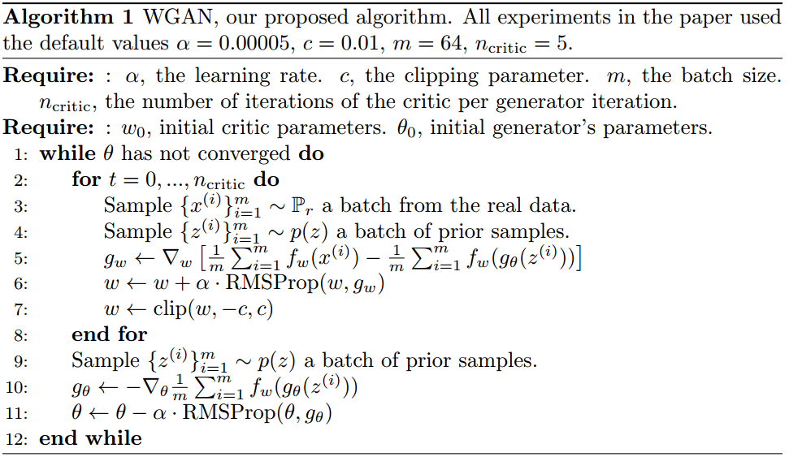
Algorithm
From “Wasserstein GAN”
https://arxiv.org/abs/1701.07875

Slide 14
Improved Wasserstein GAN (WGAN-GP)
Deep Learning

Slide 15
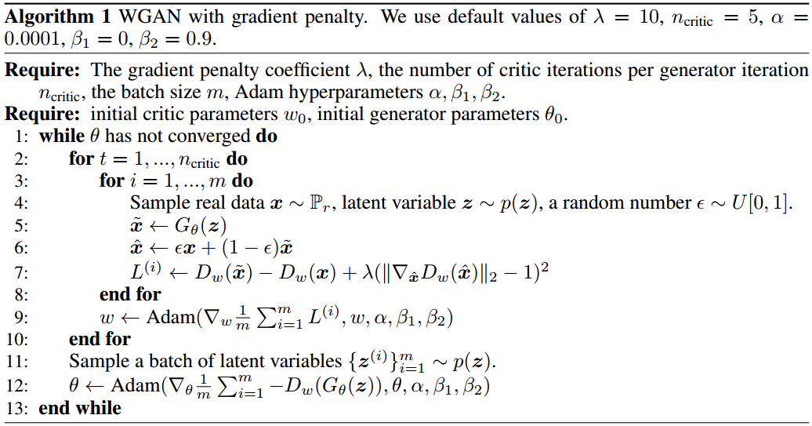
Algorithm
From “Improved Training of Wasserstein GANs”
https://arxiv.org/abs/1704.00028

Slide 16
Requirement
Using GAN To Implement DGA

Slide 17
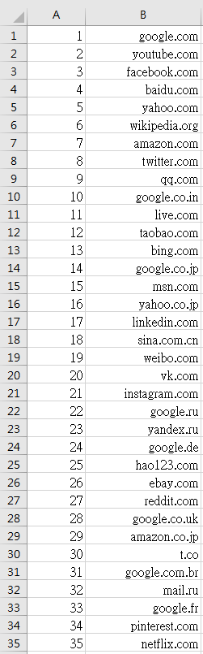
Requirement
Q: Where is my training data?
A: From Alexa Top 1-million sites.

Slide 18
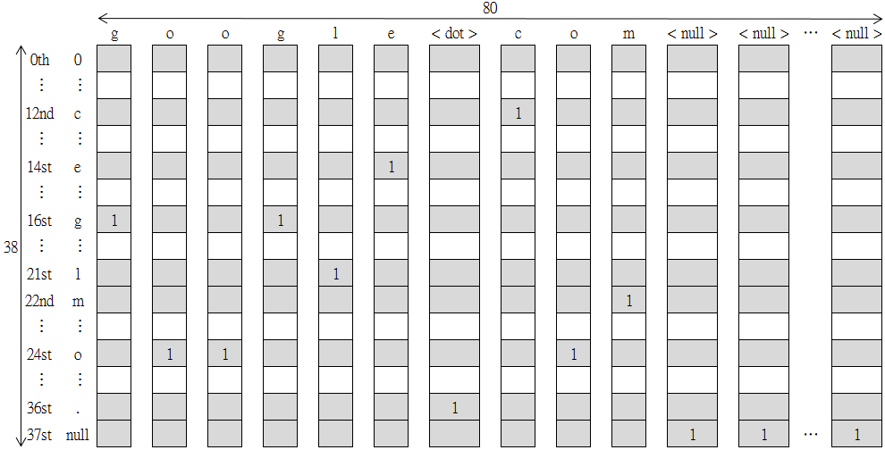
Requirement
Q: How to use this data?
A: I deal these domain names as 38x80 pictures.

Slide 19
Requirement
Because we don’t have the “code”. We have to train an Auto-encoder model.
As close as possible
NN
Encoder
NN
Decoder
code

